Slide 1
The Caribbean Union Conference
Health and Well-Being Study

Slide 2
What is this Study All about?
It is a groundbreaking study of the Adventist population within the Caribbean Union focusing majorly on health, mental health, family and women issues

Slide 3
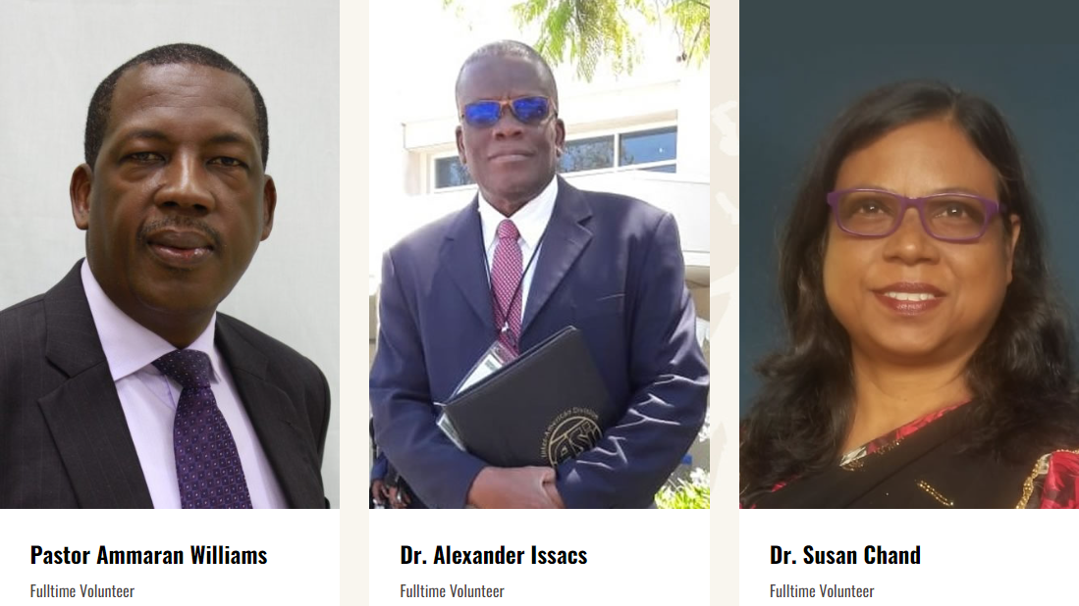
Meet the Research Team

Slide 4
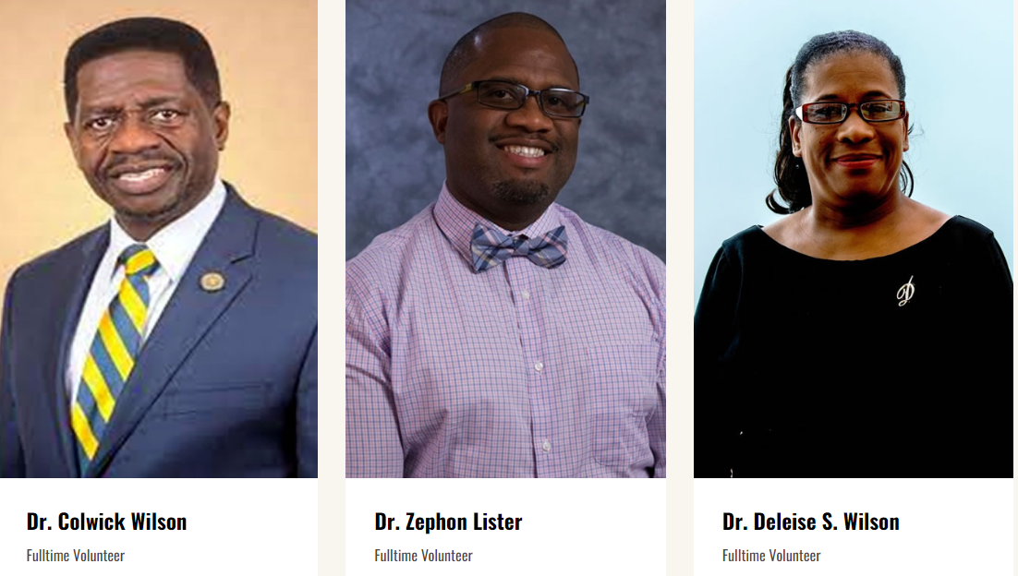
Meet the Research Team

Slide 5
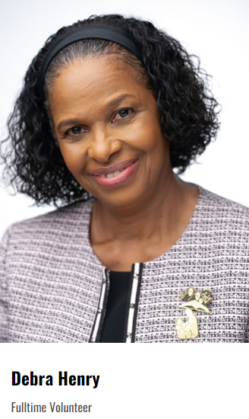
Meet the Research Team
David Williams, PhD (Johns Hopkins University)
Todd Reid, PhD (Johns Hopkins University)
Sandra Reid, MBBS, MPH, DM (Psychiatry) (University of the West Indies) Edward Clarke, PhD, MA, MBA (University of the Southern Caribbean)

Slide 6
South Caribbean Conference Research Team
Conference Directors:
Family Life Ministries, Health Ministries, Men’s Ministries & Women’s Ministries
Local Church Study Champions:
Health Ministries Leader, Family Life Leader, Men’s and Women’s Ministries leaders, Any interested member

Slide 7
What is the purpose of the study?
The goal of this study is to provide data driven ministry initiatives to improve the Health and Well being of SDA members in the Caribbean Union

Slide 8
Who is eligible to participate in the study?
Any SDA member 18 years and over is an eligible survey participant.

Slide 9
How To Take The Survey
GO to CHWBS.COM

Slide 10
Look For this to begin the survey

Slide 11
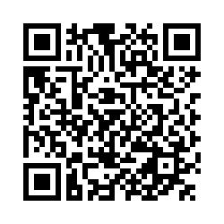
QR CODE

Slide 13
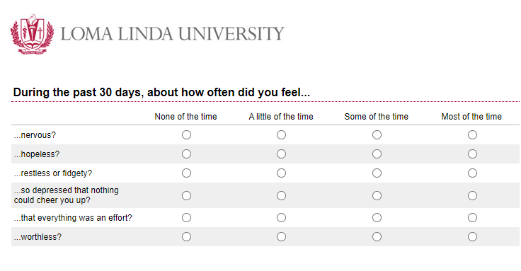

Slide 14
What Happens After the Survey is Taken?
The data is/will be collected then analyzed and interpreted then the findings are shared with the constituencies according to territories i.e. Conferences and Mission

Slide 15
Questions

